Slide 1









MOBILE APPLICATION FOR THE ARCHIVAL AND RETRIEVAL MISSING OBJECT
24
UI DESIGN AND IMPLEMENTATION

Slide 2
OUTLINE
Introduction
01
Technologies UI Principles
02
Wireframe and Demo
03
Conclusion
04

Slide 3

The previous processes were a stepping stone to this phase.
The UI was brought about from the information gotten from the users which was refined in the analysis stage,

Slide 4
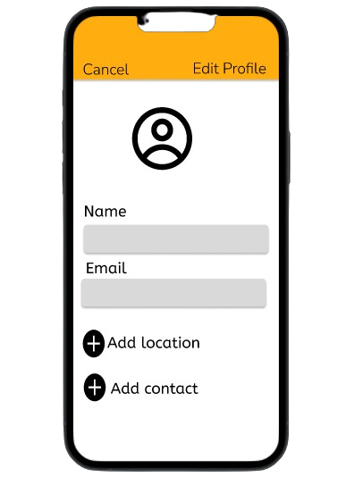
UI DESIGN PRINCIPLES
Color scheme - Orange: Stimulates action and draw attention - White: Simplicity, clearity - Gray: Neutralise, balance

Slide 5
UI DESIGN PRINCIPLES
Icon and Fonts - Font family: System Font and Nunito - Icons : accesibility, and color blind users

Slide 6
Technologies
Figma
02
Git/GitHub
01

Slide 7
React native
03
Cross platform compatibility: able to run on all platforms
Performance nature: Handle resource intensive task such as image processing
Hot reloading: Tweaking image processing algorithms

Slide 8
02
Expo go
Preview components and APIs such as camara asset and image picker
Expo sdk for image editing and manipulation

Slide 9
Wire Frame

Slide 10
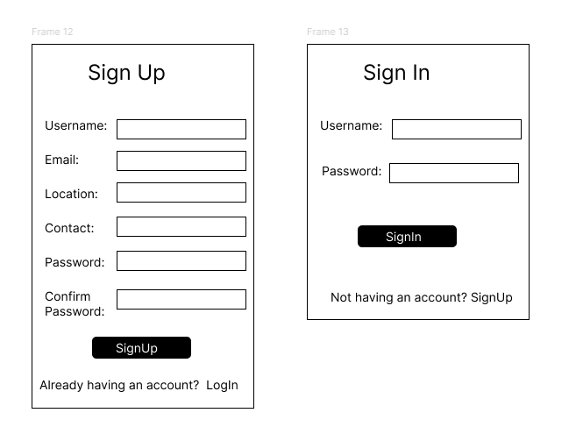
1. Authentication

Slide 11
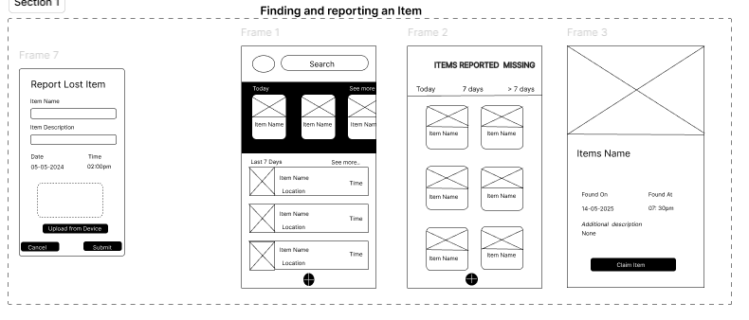
2. Finding and Reporting an Item

Slide 12
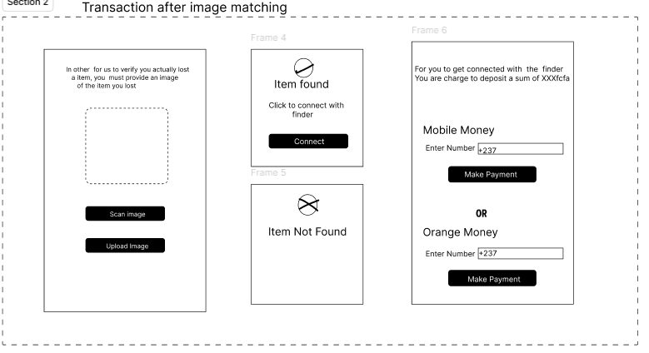
3. Transaction after Image Matching

Slide 13
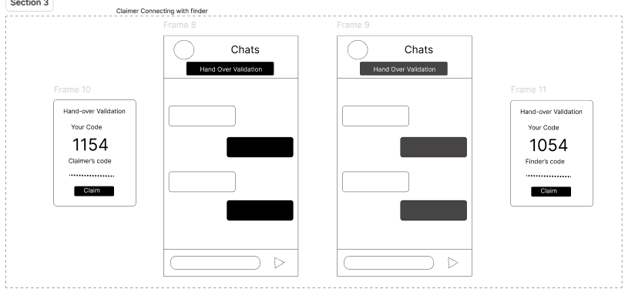
4. Claimer Connecting with the Founder

Slide 14
Prototype

Slide 15
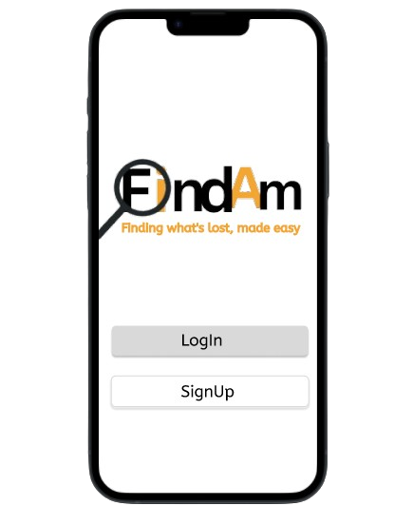
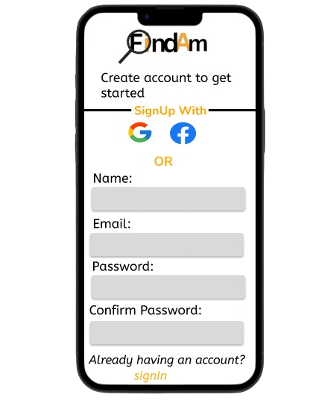
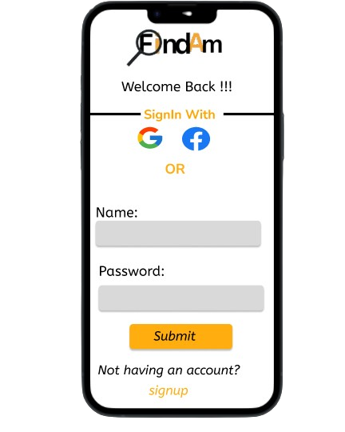

Slide 16
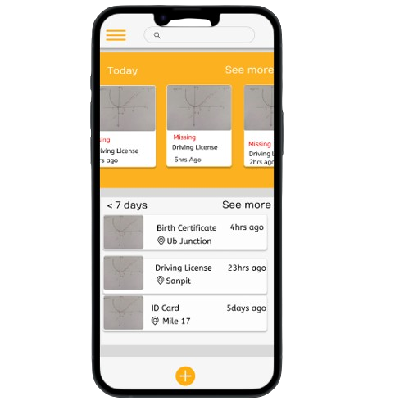
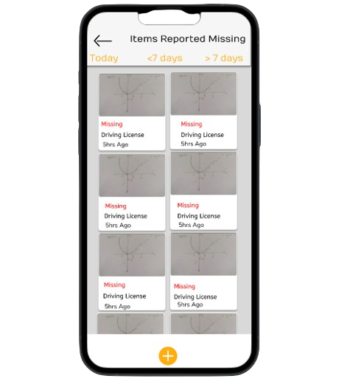
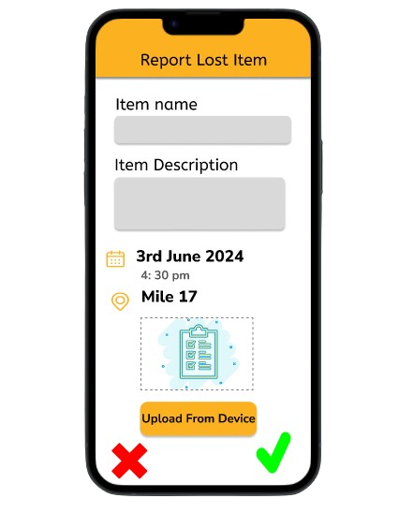
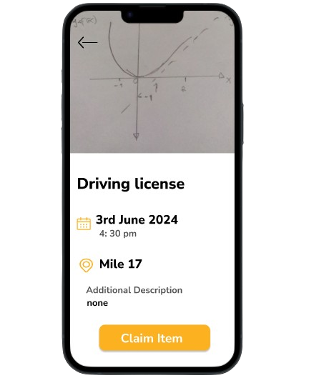

Slide 17
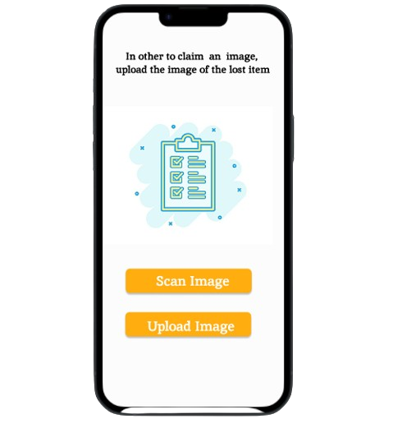
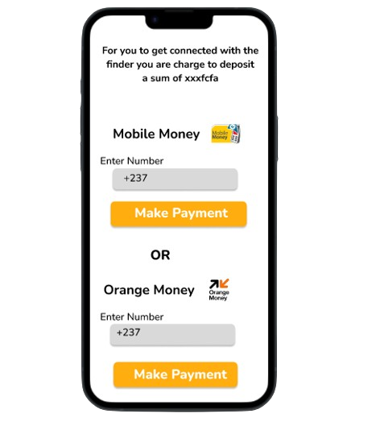
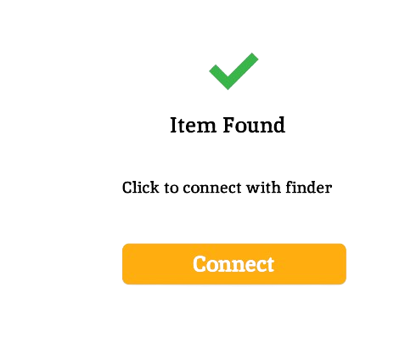


Slide 18
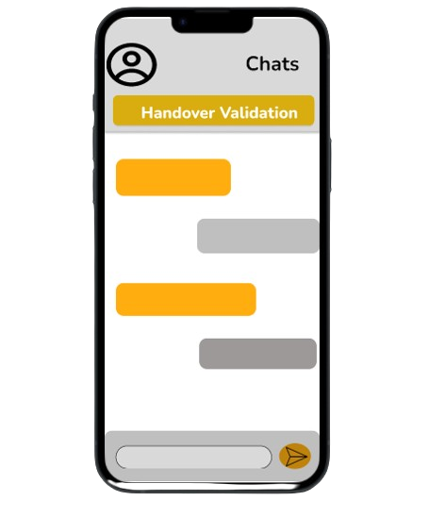
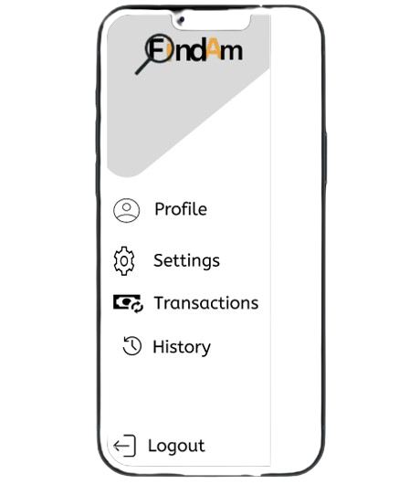
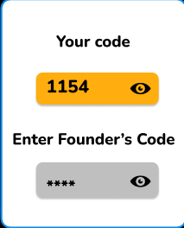
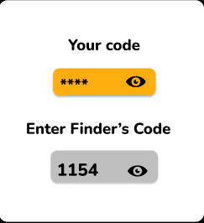

Slide 19
Demo

Slide 20
Thanks for your Keen Attention!!

